Slide 1
1 Week (2-6Dec) Security Camera Plate Reads Analysis
File created on: 12/11/2019 10:37:20 AM

Slide 2
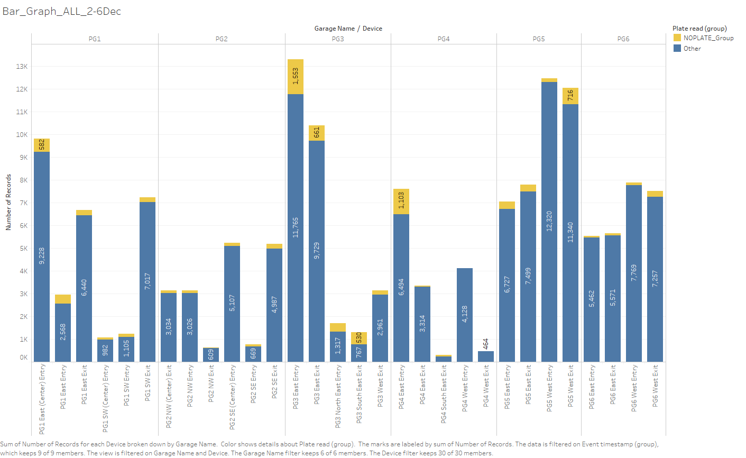
Number of no plate reads vs Plate Reads for 1 week (2-6 Dec)

Slide 3
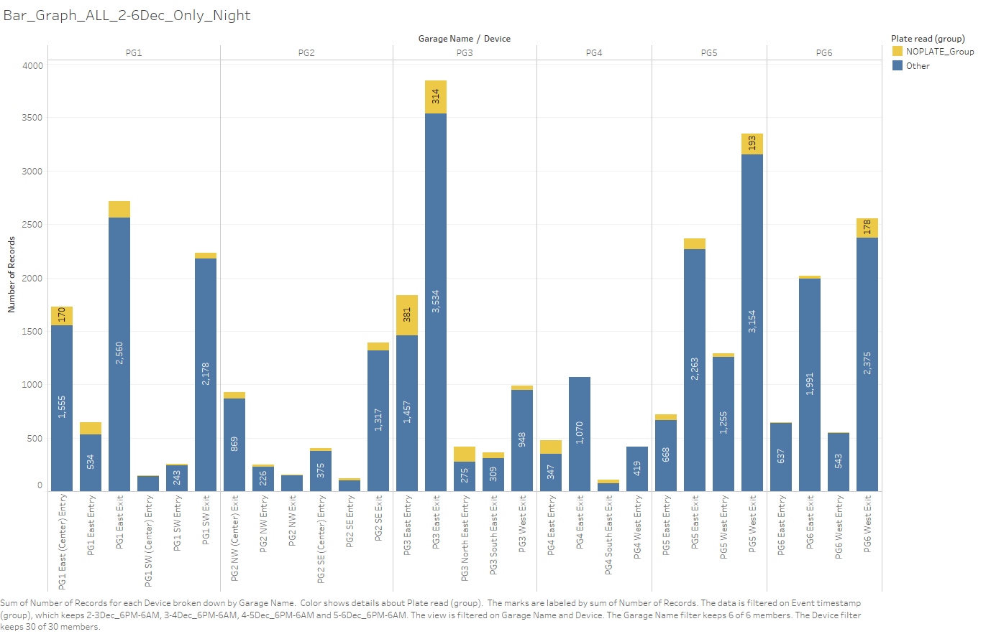
Number of no plate reads vs Plate Reads for 1 week (2-6 Dec) NIGHT Only (6pm-6am)

Slide 4
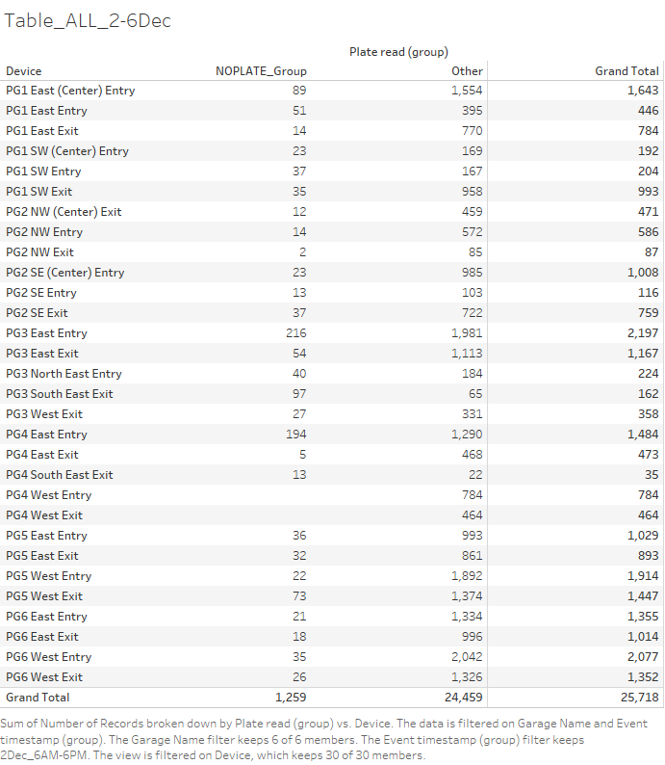

Slide 5
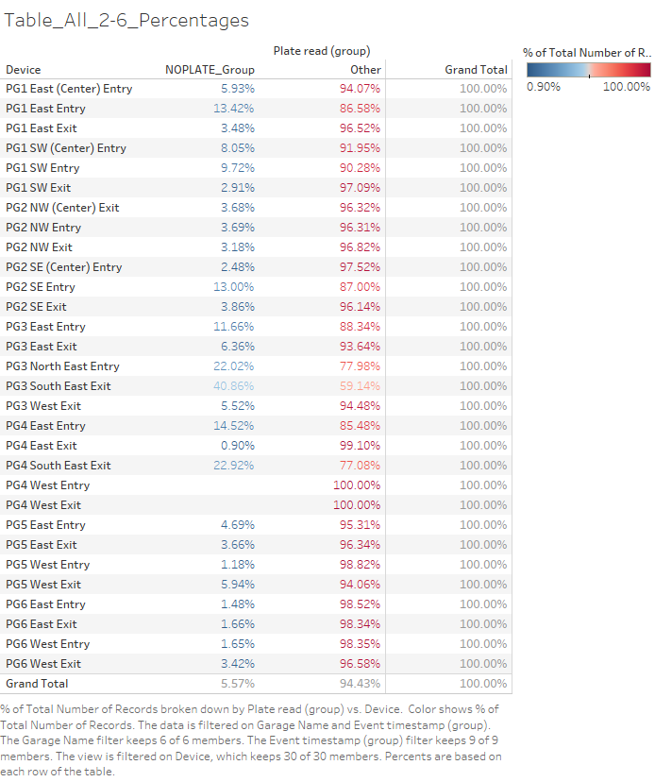

Slide 6
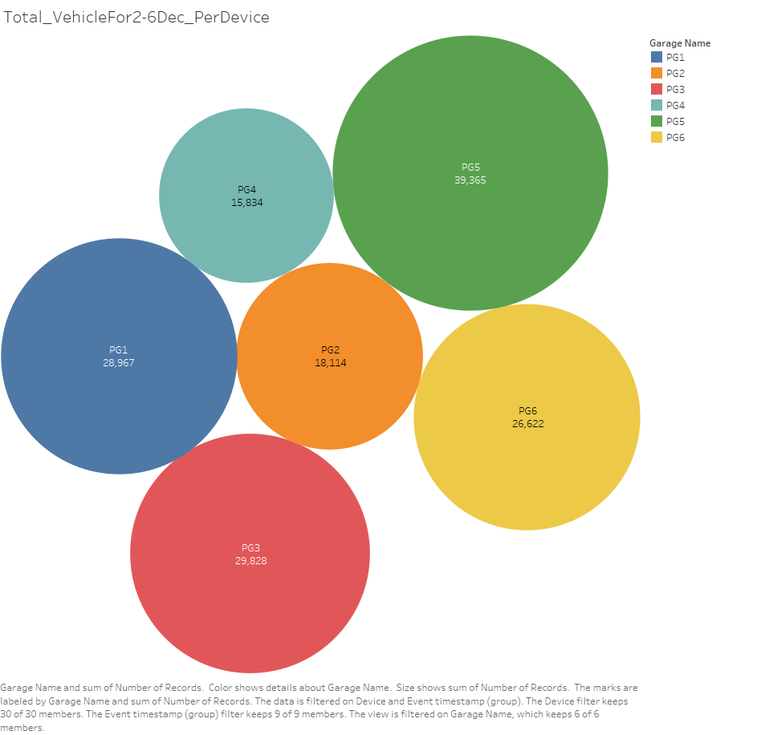
How busy Each Garages is? (Based on one week data)
PG5(39.3K)>PG3(29.8K)>PG1(29K)>PG6(26.6K)>PG2(18K)>PG4(15.8)

Slide 7
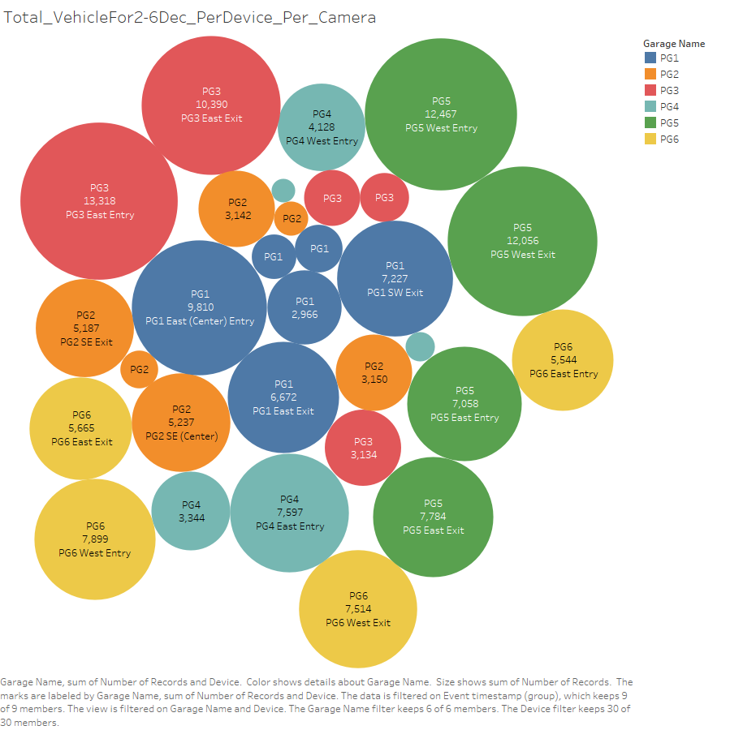
How busy Each Device is? (Based on one week data)

Slide 8
Final Insights
Very Bad (% of No Plate Read>10%)
Very Good (% of no plate Read)<2%
PG3 South East Exit(41%),
PG4 South East Exit (23%),
PG3 North East Entry (22%),
PG4 East Entry (14.5%),
Pg1 East Entry (13.5%),
Pg2 SE Entry (13%)
PG4 West Entry (0%)
PG4 West Exit (0%)
PG5 West Entry (1.1%)
PG6 East Entry (1.5)
PG6 East Exit (1.6%)
PG6 West Entry (1.6%)

